Slide 1
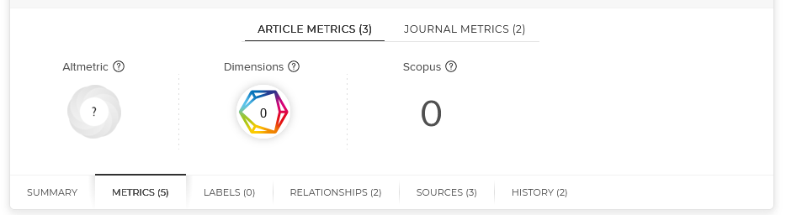
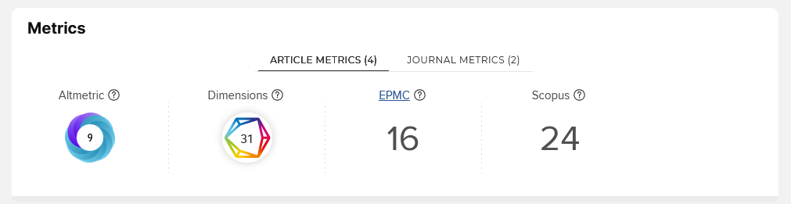


Symplectic Elements – Article Metrics
Altmetric
Product of Digital Science
Tracks social media mentions of a research product (e.g., Wikipedia, blogs, policy documents, social media, etc.)
Dimensions
Product of Digital Science
Tracks citation counts
Provides Normalized Citation Metrics (FCR, RCR) for assigned Fields of Research (FOR)
And more …
Symplectic Elements also harvests metrics from other sources when available (e.g., Scopus)
Notes:
Talking points:
Discuss how article metrics appear in SE (when inputting data and on the public profile)
Discuss Altmetrics, Dimensions, and other metrics briefly

Slide 2
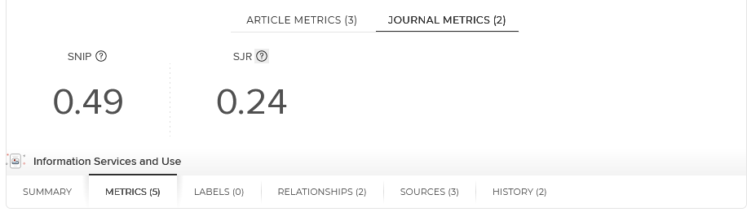
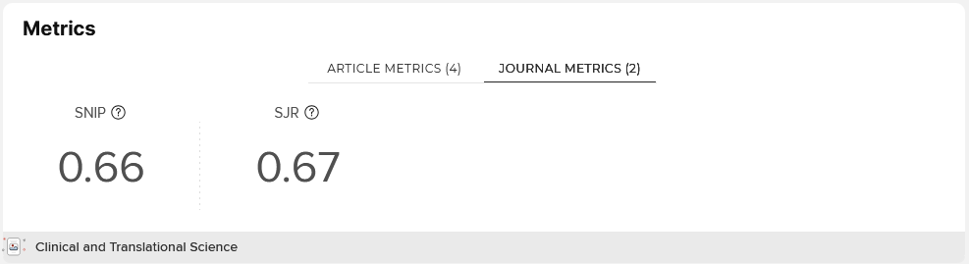
Symplectic Elements – Journal Metrics
SNIP
Source Normalized Impact per Paper (SNIP): the number of citations given in the journal's present year to publications in the past three years divided by the total number of publications in the past three years adjusted to the citation norms of the journal's discipline.
SJR
SCImago Journal Rank (SJR): a measure of journal influence in a subject category based on citations received (as tracked by Scopus) and the influence of the source of those citations. It is based on the Google PageRank algorithm.
Notes:
Talking points:
Discuss how journal metrics appear in SE (when inputting data and on the public profile)
Discuss SNIP and SJR metrics briefly
Mention gaps in Scopus coverage

Slide 3
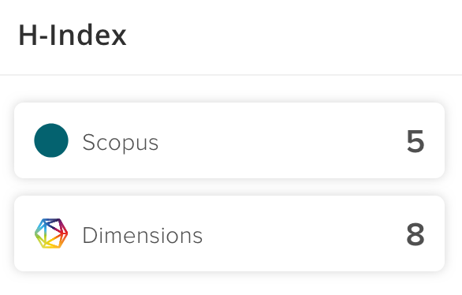
Symplectic Elements – Author Metrics*
h-index
calculated by counting the number of publications for which an author has been cited at least that same number of times … for example, in the example to the left, an h-index of 5 means that 5 of the author’s articles have been cited at least 5 times
* Not recommended; the metric behaves unpredictably and tends to reflect length of career more than anything else. For example, a person with a few highly influential works would look no more significant than a person with several modestly cited works.
Notes:
Talking points:
Discuss how author metrics appear in SE (when inputing data … does not appear on the public profile (but you’ll need to confirm this because in the pilot site it doesn’t…))
Discuss h-index briefly

Slide 4
Uses
Limitations
A starting place to collect metrics about your scholarly works
Altmetric provides links to mentions of your work that may demonstrate broader social impact (news coverage, policy works, etc.)
Dimensions includes several useful citation-based metrics about your work:
  Total citations per work
  Field Citation Ratio (FCR): a normalized citation metric that enables comparison of how your work is cited with other works published in that year and in the same field
  Relative Citation Ratio (RCR): similar to FCR, but limited to articles funded by the NIH
These metrics can demonstrate the specific impact of your work independent of perceived journal prestige
Not all publications are tracked by citation databases (e.g. Scopus, Dimensions, etc.)
It takes time for a work to be cited
Citation counts vary depending on the source used. Dimensions is larger that most databases, but Google Scholar will often report a higher citation count.
The mentions reported by Altmetric are more meaningful that the calculated Altmetric Attention score.
Similar to the Journal Impact Factor (JIF), SJR and SNIP are journal-level metrics. These speak to the relative influence of the journal and may not reflect the value of your article. Learn more: https://researchmetrics.indianapolis.iu.edu/resources.html
Notes:
Talking points:

