Slide 1
THE System for Documenting Faculty Accomplishments and Activities
ELEMENTS OVERVIEW
Notes:
Welcome and thank you for joining us today for Elements Expert training. Before we jump into the program just a few housekeeping details.
Bathrooms are just down the hall.
Lunch will be served here. We are having Panera.
There are long extension cords for your power cords, just share with others as needed.

Slide 2
Agenda
Purpose and Future of Elements
Accessing and Navigating the System
Understanding Activity Types
User Profiles
Importing and Harvesting Publications
Support Tools and Resources
Open Lab and Questions

Slide 3
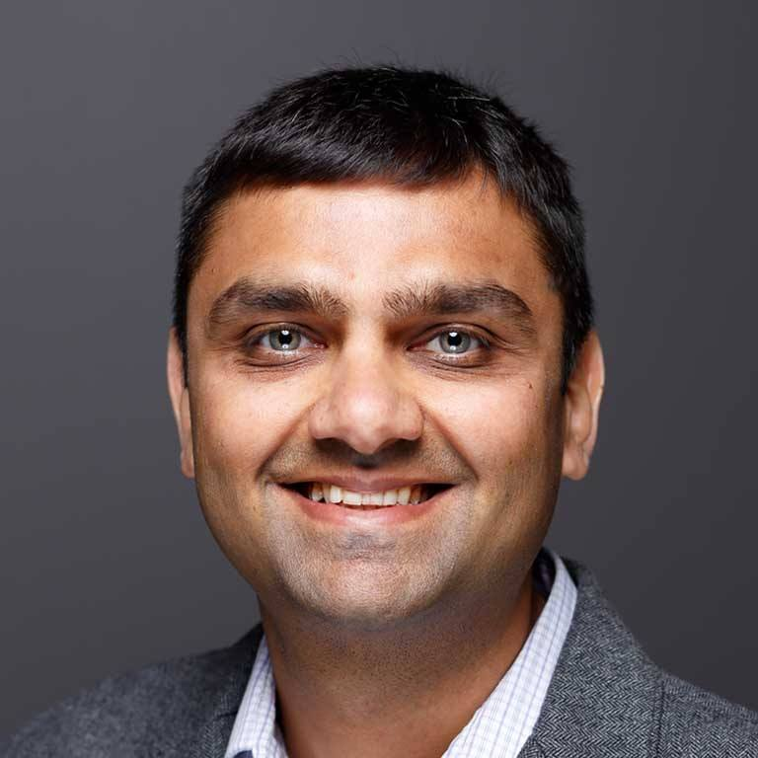
The Team
Brandalynn White
Academic Systems
Akash Shah
Academic Systems
The core implementation team is led by Academic Systems with UA level support from Strategic Operations and UITS Enterprise System’s staff.
Liz Osika
Strategic Operations
Lora Fox’s
Enterprise Systems Staff
Notes:
So, let’s jump into our work and start with introductions of the Elements Implementation Team and then you will have the opportunity to get to know your neighbors.
If any of the team is present, make sure to point them out.
Introduce core team [move slide]
Faculty engagement and direction are critical for this project. To this end, we have incorporated the voice of the faculty in the following ways:
Introduce faculty on team [move slide]
Provide overview of pilot based on slide data remember to talk about the challenges and feedback on instructional materials
[Ask] Is there anyone in the room who is a participant in the ongoing Elements Pilot project? If so, can you raise your hand? If individuals raise their hands, ask if they would like to say anything about the pilot.

Slide 4
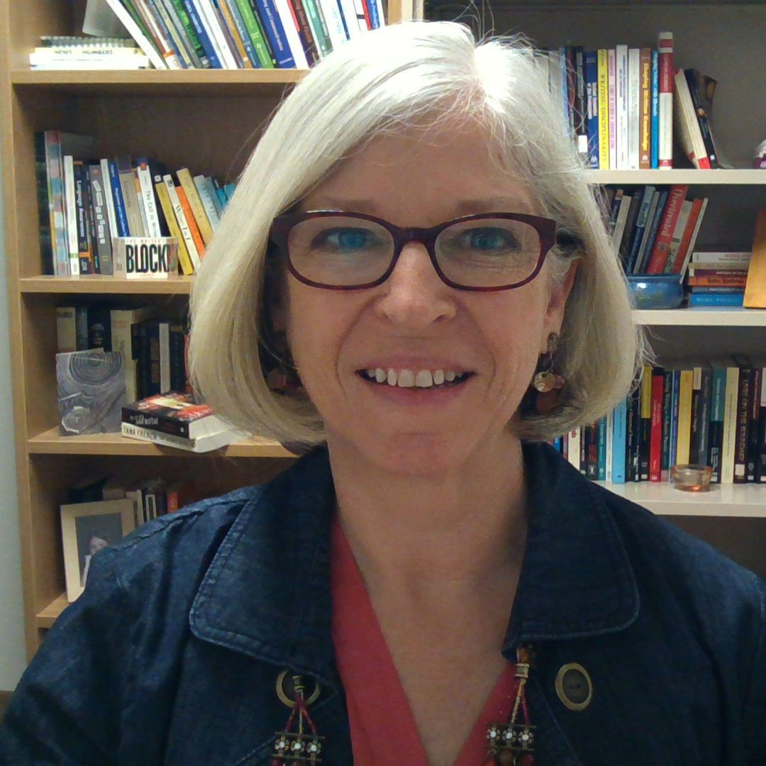
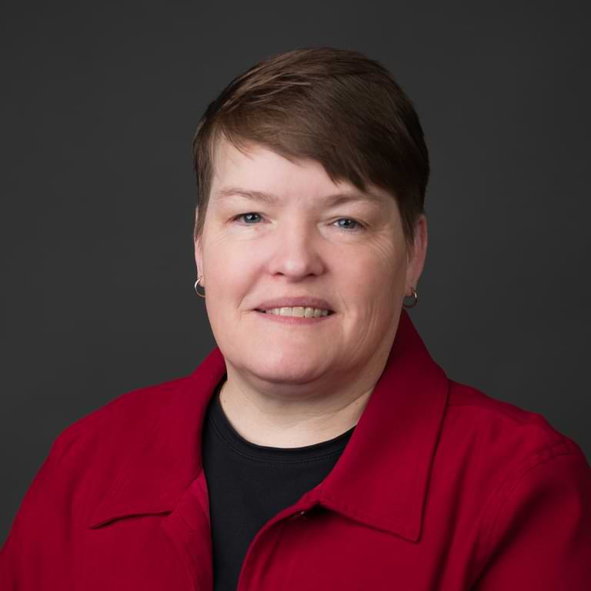
The Team
Willie Miller
Indianapolis
Susan Popham
Southeast
The full implementation team includes faculty representatives from all constituent groups who represent the needs and interests of faculty.
Sarah Heath
Kokomo
Logan Paul
Bloomington
Melody Braun
School of Medicine

Slide 5
The Pilot Team
Participants from Every Campus
IUB | 56
IUC | 1
IUE | 2
IUFW | 1
IUI | 32
IUK | 5
IUNW | 5
IUS | 1
IUSB | 8
IUSE | 5
IUSM | 14
Grand Total | 130
The pilot team includes volunteers from every campus who work through specific challenges to locate and help resolve issues and concerns before the system-wide release.
Changes Based on Pilot Recommendations
45 and Counting
Notes:
] Is there anyone in the room who is a participant in the ongoing Elements Pilot project? If so, can you raise your hand? If individuals raise their hands, ask if they would like to say anything about the pilot.

Slide 6
Purpose and Future of Elements

Slide 7
Identifying the Need
DMAI was not serving the needs of the faculty for reporting faculty activities.
Common complaints included:
Clunky User Experience
Too many fields!
Caused duplicative work for faculty (e.g. online profiles, annual review)
And duplicative work for campuses (e.g. awards and reporting)
The goal was to find a system that:
Simplify activity reporting for faculty.
Provide faculty a greater benefit to reporting activity.
Allow for process optimization for various workflows for administrators. (e.g., Annual Review, P&T, others)
Notes:
Review the information on the slides for this section. Highlight that this system is THE system for documenting faculty activities and accomplishments.
Configuration is not a direct copy of DMAI – reconfigured based on previously reporting practices and feedback from faculty.
Re-tooling current feeds and creating new feeds to ensure data in Elements is consistent and useful
[Ask] Do you have any questions about this information?
Introduce Brandalynn I am now going to turn over the floor to Brandalynn White, the administrator dedicated to Elements.
[move slide]

Slide 8
The Review Process
Develop a Request for Proposals
Task Force Members included:
9 faculty from the various Faculty Councils
2 Associate Deans
4 individuals from Academic Affairs
3 individuals from UITS
Review Activities:
Developed Criteria Matrix
Vetted 6 supplier proposals
Viewed 2 supplier’s products
Determined to move forward with Symplectic Elements

Slide 9
Why Elements?
Elements provides:
An easier user interface for improved faculty experience
Automated scholarly matching to reduce manual entries for faculty in certain disciplines
Bibliographic import capabilities to support broader disciplines and varied publications
Enterprise–wide web profiles for less duplication of work
Workflow and routing capabilities for simplified processing
Continual improvement by revisiting why we did things before and how we can do them better in Elements for an overall improved experience

Slide 10
The Purpose of Elements
Become THE system for documenting faculty activities and accomplishments
This will be the source for IU administrators to review and report on faculty’s accomplishments and work in:
Scholarly work and publications
Leadership and service
Teaching activities and materials
Grants and contracts
Various workflows (Annual Reviews, P&T, others)

Slide 11
Implementation Timeline
Spring 2024
Selection of Elements
Summer 2024
Configuration
Fall 2024
Continued Configuration
Setup Starter Data Feeds
Move Data into Elements
Faculty Pilot
Not a DMAI copy
New and better feeds
Discovery Profiles
Winter 2024
Available to All Faculty
Spring 2025
SoM specific configuration
2025
Finalize SoM Configuration
Additional Workflows
Annual Review Pilot
Training
Continued training and support

Slide 12
Accessing and Navigating the System

Slide 13
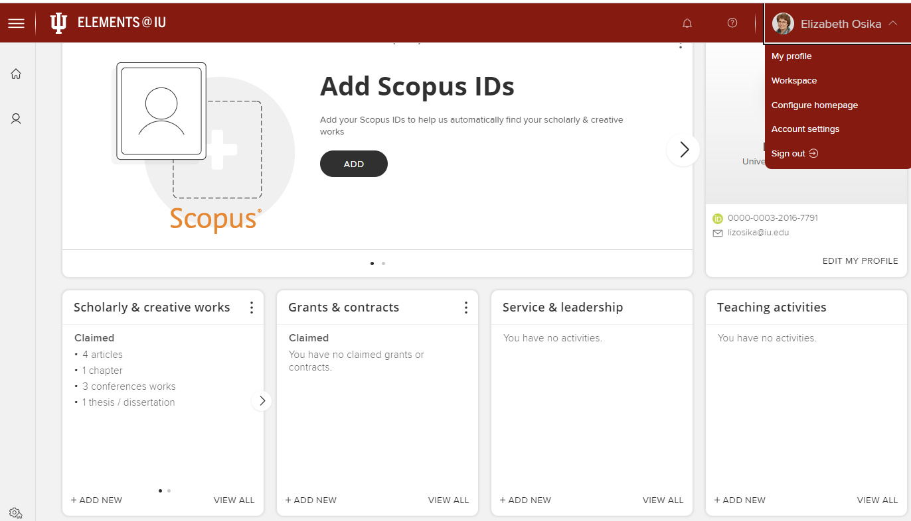
Main Menu
Account Options
Homepage
Profile
Action Panel
Categories
Activities
Add Activity

Slide 14
Accessing the System
URL for Elements System
https://elements.iu.edu

